Slide 1
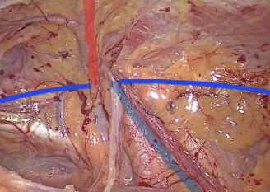
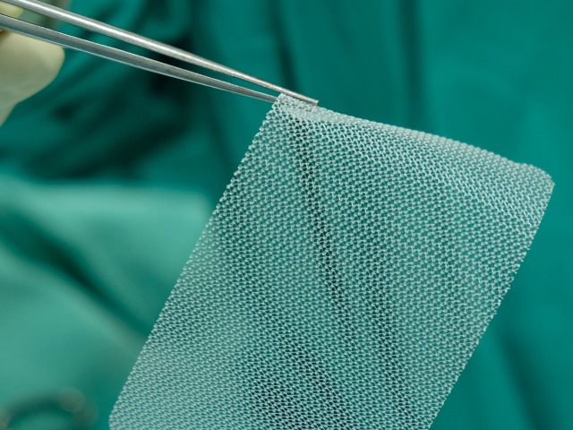
Mesh and fixation in Laparoscopic inguinal hernia repair
Mr Duncan Light
Consultant upper GI surgeon
Northumbria NHS Trust
www.nugit.nhs.uk

Slide 2
Mesh classification
Synthetic
Polypropylene
PVDF
Polyester
Biosynthetic
PGA
P4HB
Biological
Porcine
Bovine
Fetal
Cadaver
Structure/weave
Pore size
> 1mm
Weight
80gm²
Mechanical properties
Tensile strength
Stiffness
Elasticity
Complicance

Slide 3
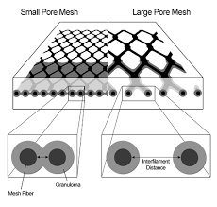
Mesh immune response
Foreign body response
Fibroblasts and immune response
Chronic process
Granuloma formation
Scar plate
Implicated in mesh shrinkage
Potential reduction with large pore size (>1mm)

Slide 6
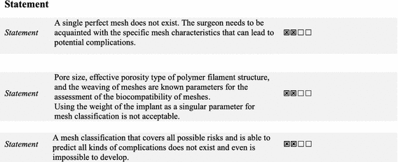

Slide 7
RECURRENCE
CHRONIC PAIN
WOUND COMPLICATIONS
QUALITY
VALUE
=
--------------------
COST
READMISSIONS
HOSPITAL VISITS
LOS
RESOURCES

Slide 8
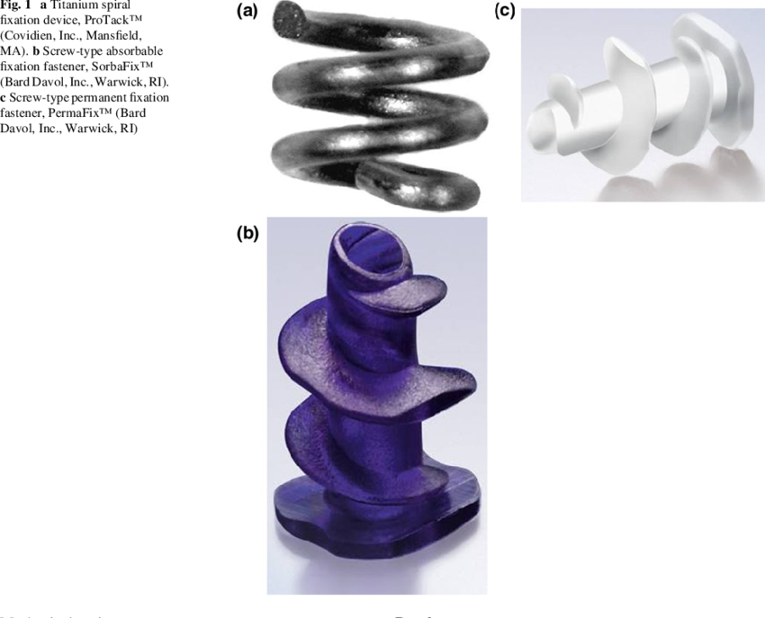
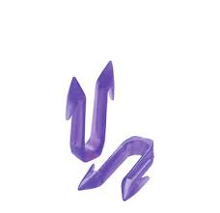
Fixation
Tacks
Absorbable
Non-absorbable
Staples?
Glue
Fibrin
Cyanoacylate
Self-fixating mesh

Slide 9
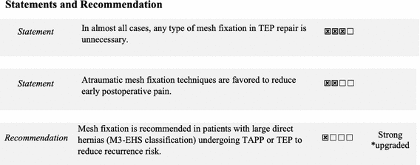
Fixation

Slide 10
RECURRENCE
CHRONIC PAIN
WOUND COMPLICATIONS
QUALITY
VALUE
=
--------------------
COST
READMISSIONS
HOSPITAL VISITS
LOS
RESOURCES

Slide 11
References
International guidelines for groin hernia management. Herniasurge group. Hernia 2018. 22 (1): 1-65
Past, Present and Future of Surgical Meshes: A Review. Baylon, Karen & Rodríguez-Camarillo, Perla & Elías-Zúñiga, Alex & Díaz-Elizondo, José & Gilkerson, Robert & Lozano, Karen. (2017). Membranes. 7. 47

